Slide 1
Salesforce to HireSmith Data Integration
INFM 737 Capstone Project
Abdul Shaik, Shun-Ting Wang

Slide 2
Introduction
Launch Date & Purpose Initiated on September 28, 2023, to enhance data synchronization between HireSmith and Salesforce.
Focus One-way data sync from Salesforce to HireSmith.
Objectives Automate data entry, support job searches in the Smith School’s career portal.
Collaborate with Smith IT for seamless data flow.

Slide 3
The Problem
Manual Data Updates:
Previous reliance on manual updates from SIS and ERx, leading to inefficiencies and potential inaccuracies.
The time and human hour cost associated with manual update have to be reduced.
Need for Automation:
Growing demand for streamlined data management processes.
Requirement for real-time, accurate student data integration.
Notes:
Addressing data quality consistency issue, reducing the cost of managing data.

Slide 4
The Solution
Automated Data Flow System:
Development of an automated data sync system from Salesforce to HireSmith.
Inclusion of all relevant student data fields and types in a structured SQL database.
Database Structure
Creation of “student_degree” and “student_profile” tables and “student”view
Lookup Tables
Implementation of lookup tables via Python scripts for efficient data management.
Collaborative Effort with Smith IT:
Ensuring alignment of Salesforce student database with project needs.
Establishing seamless integration for data flow into SQL database.
Notes:
Automated System: Development of an automated data sync system from Salesforce to HireSmith.
Database Structure: Creation of student_degree and student_profile tables.
Lookup Tables: Implementation of lookup tables via Python scripts for efficient data management.

Slide 5
The Challenges
Integration Complexities:
Handling complex data structures and relationships.
Aligning Salesforce data fields with HireSmith requirements.
Technical Challenges:
Developing robust Python scripts for efficient data synchronization.
Ensuring database integrity and accurate data translation.
Notes:
Put a graphic to explain

Slide 6
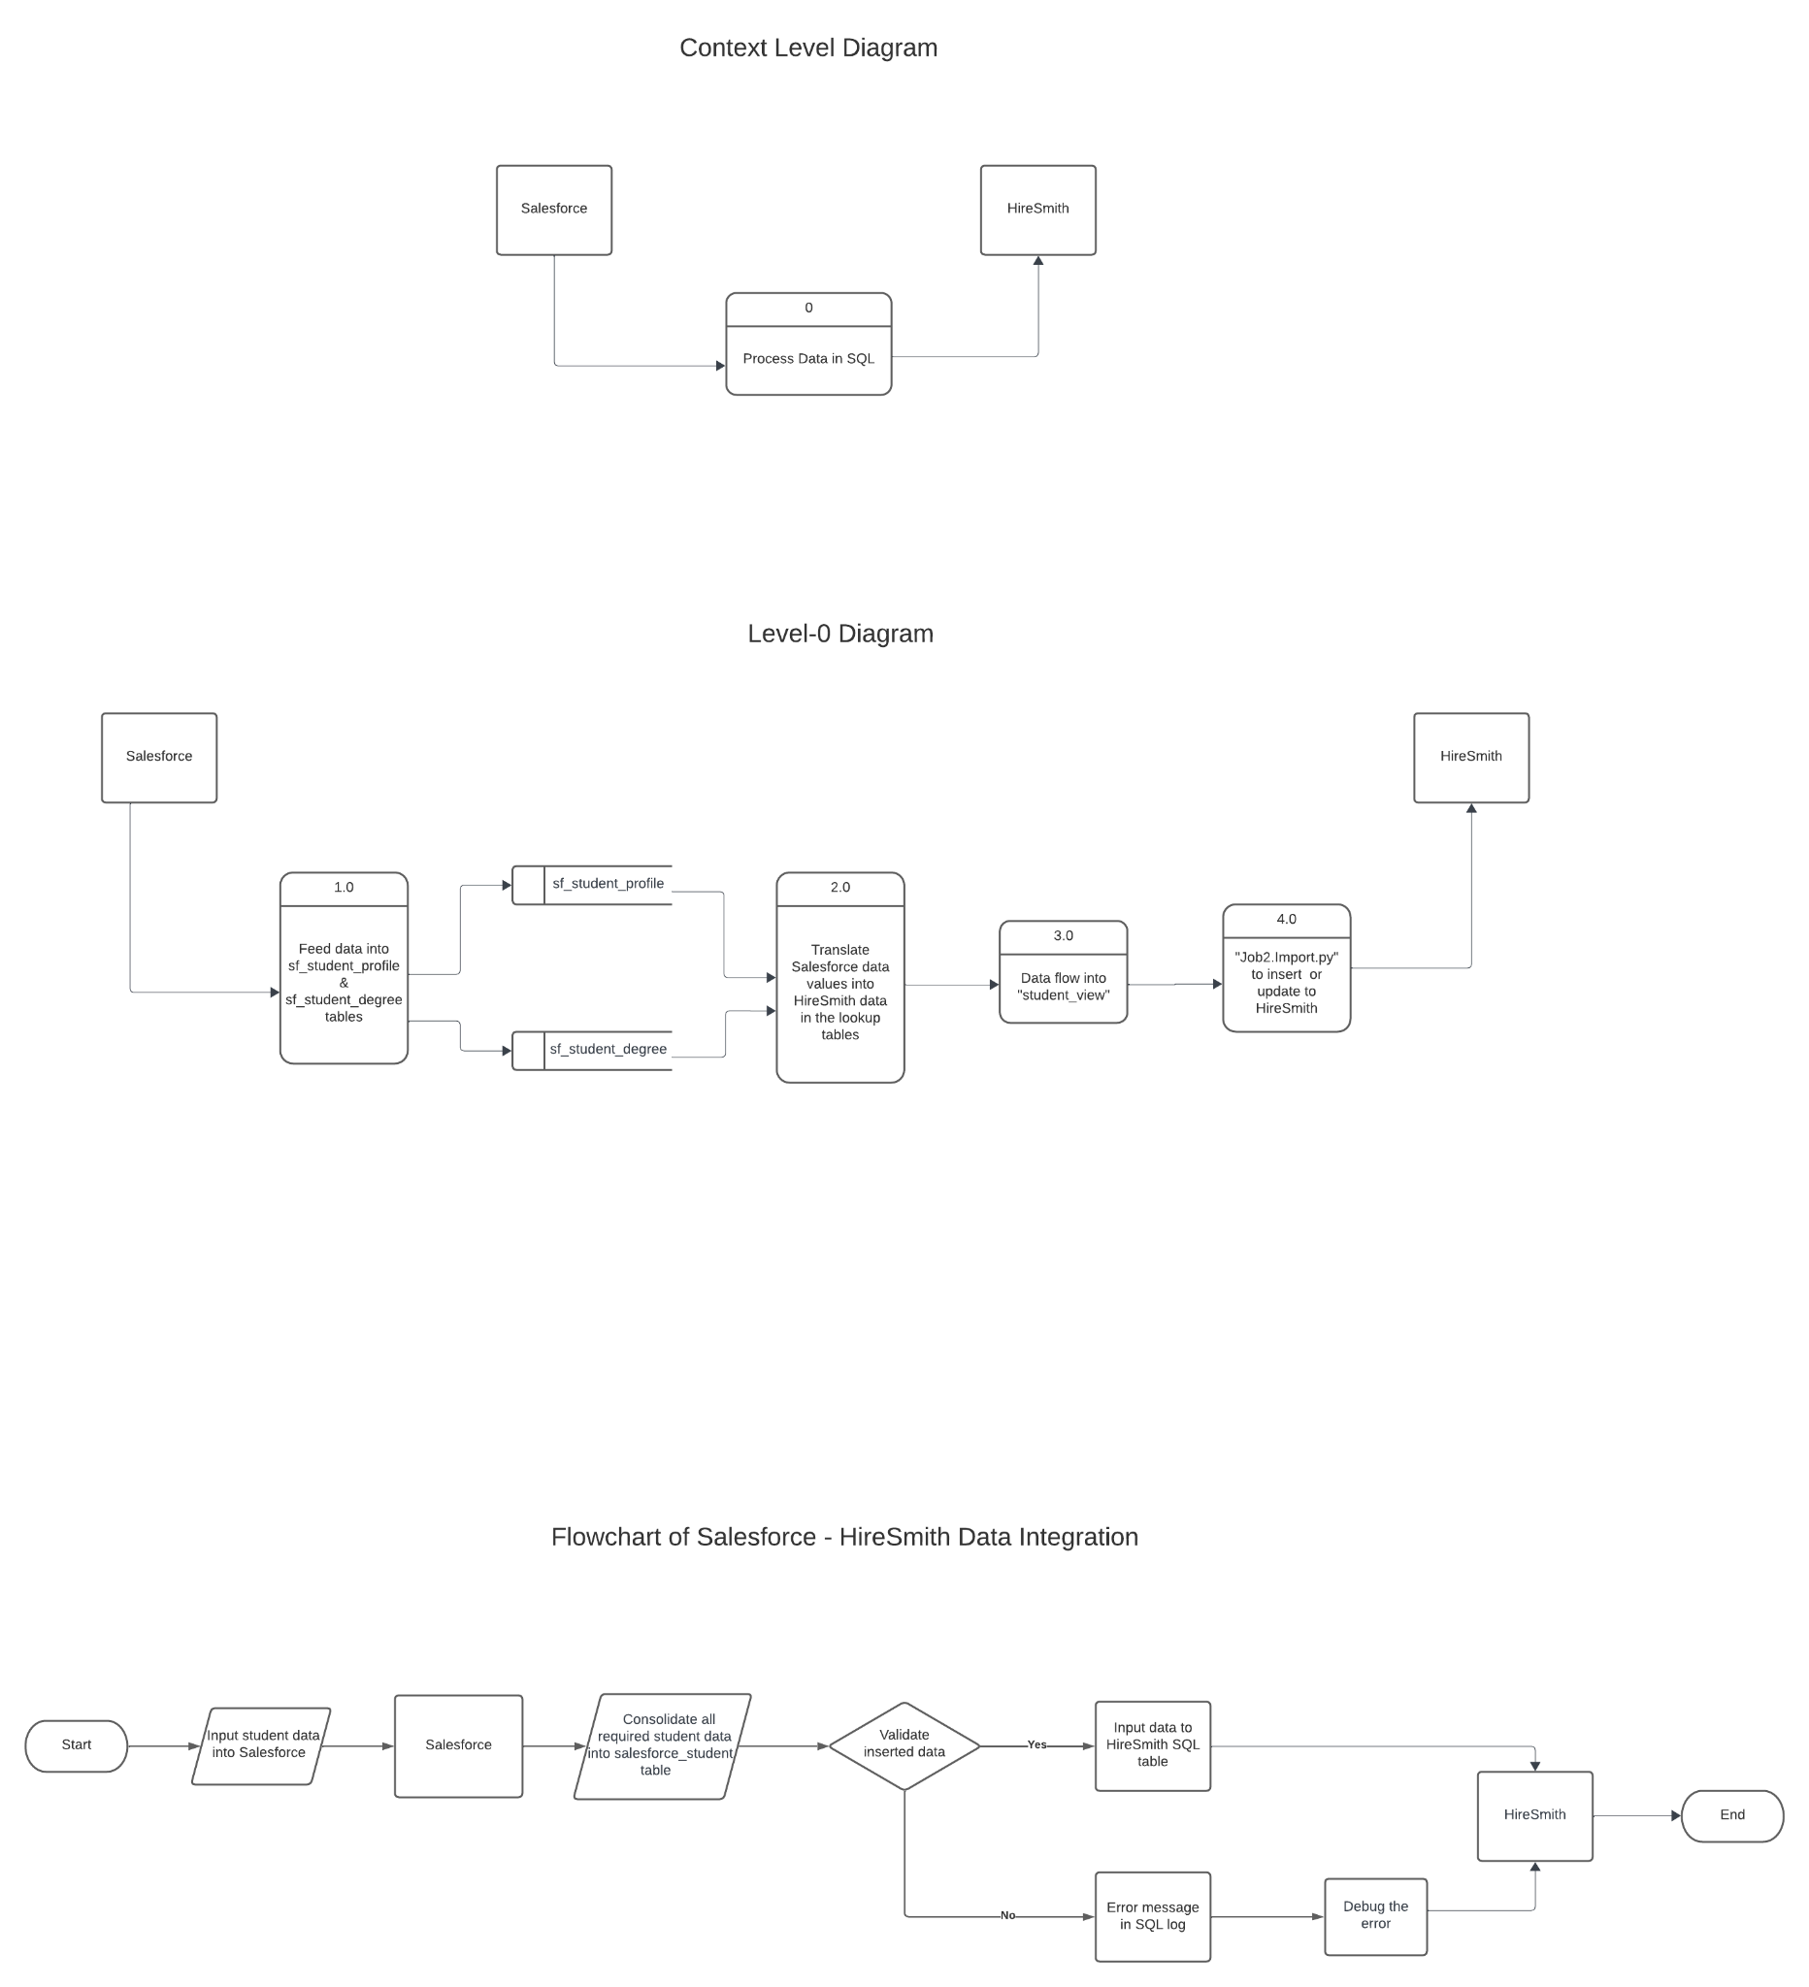
Data Flow Chart
Notes:
Successful Data Synchronization:
Automated data sync replacing manual processes.
Improved accuracy and efficiency in student data management.
Enhanced Operational Efficiency:
Streamlined data management processes.
Real-time data updates ensuring current and accurate information.

Slide 7
ER Diagram
Notes:
Successful Data Synchronization:
Automated data sync replacing manual processes.
Improved accuracy and efficiency in student data management.
Enhanced Operational Efficiency:
Streamlined data management processes.
Real-time data updates ensuring current and accurate information.

Slide 8
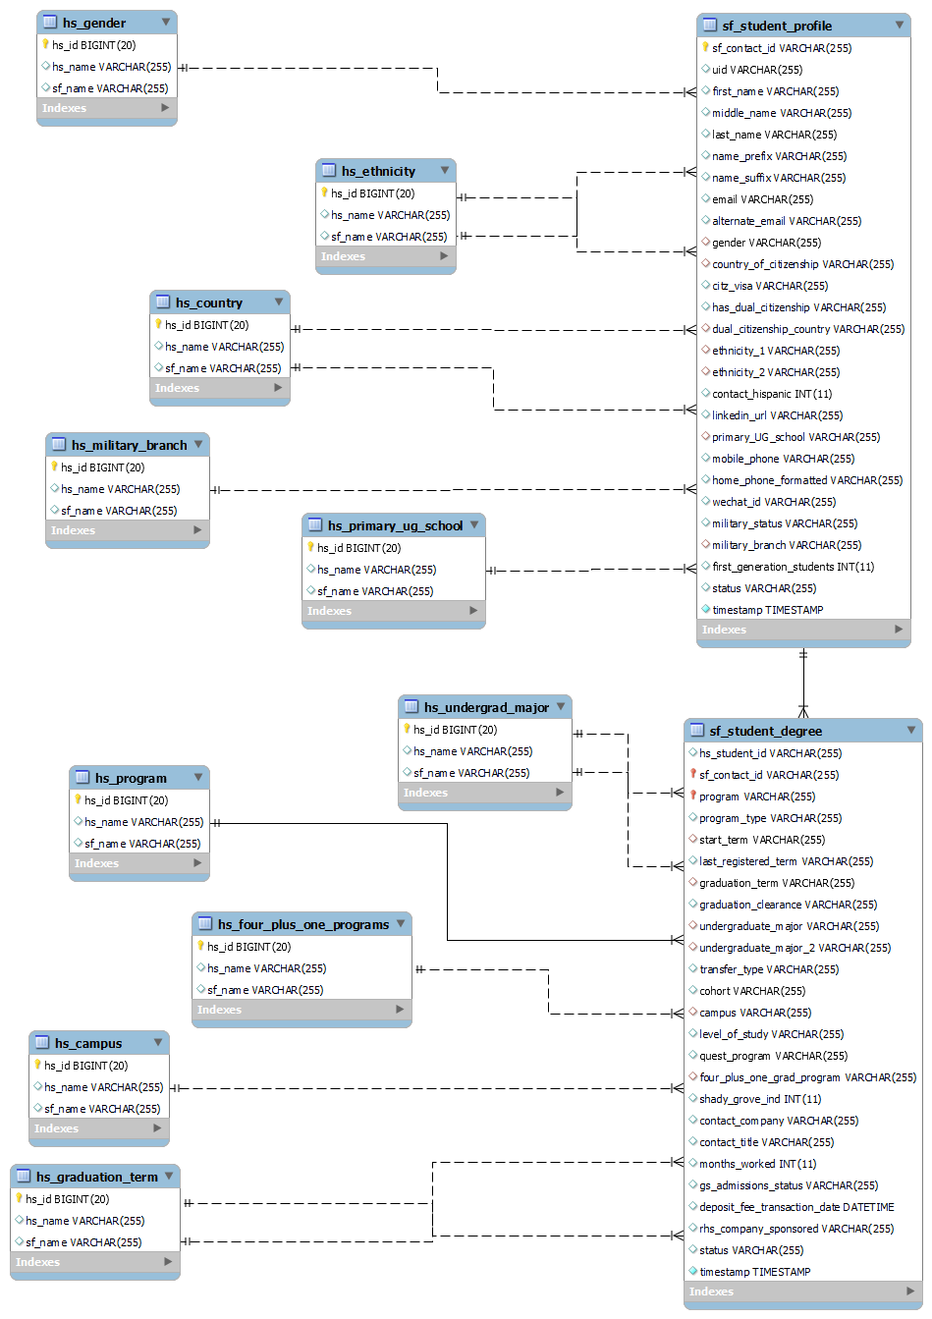
Notes:
Successful Data Synchronization:
Automated data sync replacing manual processes.
Improved accuracy and efficiency in student data management.
Enhanced Operational Efficiency:
Streamlined data management processes.
Real-time data updates ensuring current and accurate information.

Slide 9
Notes:
Successful Data Synchronization:
Automated data sync replacing manual processes.
Improved accuracy and efficiency in student data management.
Enhanced Operational Efficiency:
Streamlined data management processes.
Real-time data updates ensuring current and accurate information.

Slide 10
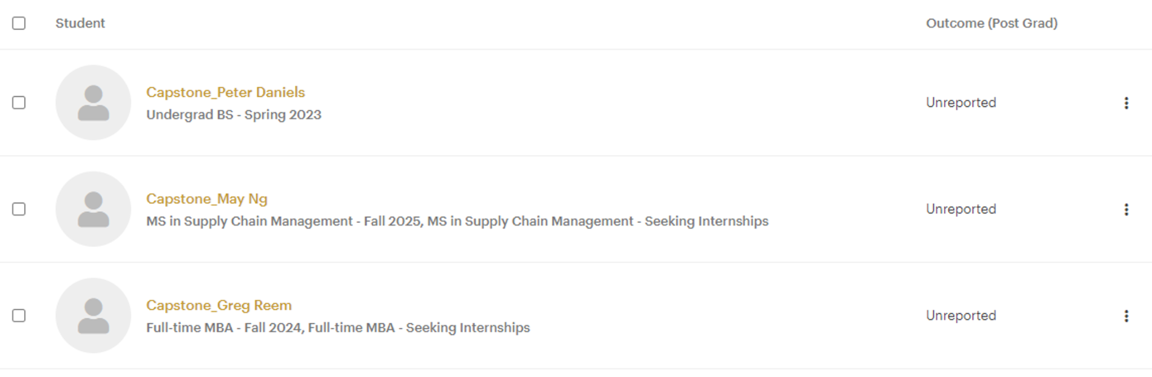
The Results
Notes:
Successful Data Synchronization:
Automated data sync replacing manual processes.
Improved accuracy and efficiency in student data management.
Enhanced Operational Efficiency:
Streamlined data management processes.
Real-time data updates ensuring current and accurate information.

Slide 11
The Results
Notes:
Successful Data Synchronization:
Automated data sync replacing manual processes.
Improved accuracy and efficiency in student data management.
Enhanced Operational Efficiency:
Streamlined data management processes.
Real-time data updates ensuring current and accurate information.

Slide 12
Next Steps
Further Development
Continuous Monitoring and Optimization:
Regular assessment and refinement of the system to enhance performance and efficiency.
Expanding Automation Scope:
Investigating opportunities to extend automated processes to other data management areas within the system.
Preparation for Real Data Integration:
In anticipation of Smith IT initiating data integration next semester, preparations are underway to ensure a smooth transition from mockup data to real data flow into the SQL database.
Stakeholder Engagement
Collaboration with Smith IT:
Maintaining an active partnership with Smith IT, working closely to align system capabilities with upcoming data integration.
Feedback and Enhancement:
Continuously engaging with stakeholders to solicit feedback and suggestions, aiming to incorporate these insights into system enhancements and updates.

Slide 13
Questions?
Any questions?

Slide 14
Notes About the Presentation
These are questions you need to answer before putting the deck together:
Who is the audience?
What message do you want to convey?
Are you asking for something at the end?
Challenge: Complete the presentation in fewer than 10 minutes

